Slide 1
matematika diskrit 2: matriks DAN OPERASI ARITMATIKANYA
Ayu Latifah, ST., MT.

Slide 2
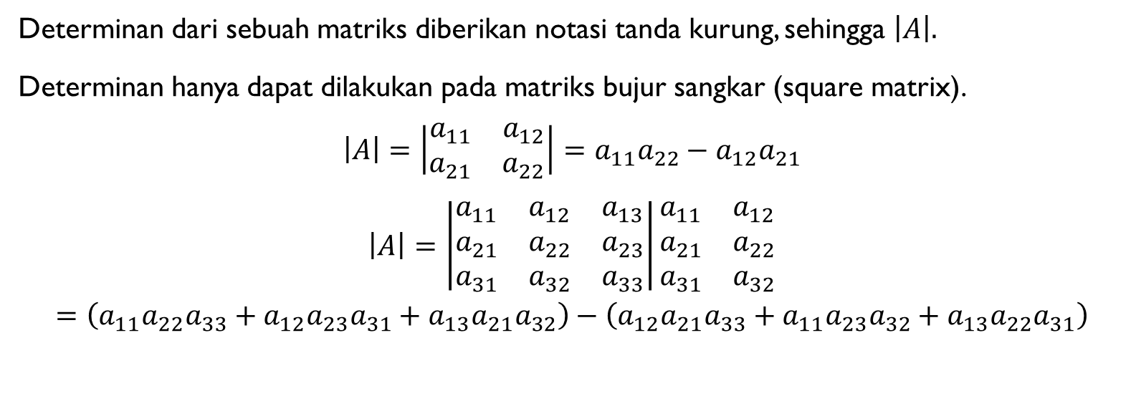
DETERMINAN
Determinan dari sebuah matriks diberikan notasi tanda kurung, sehingga $\left|A\right|.$
Determinan hanya dapat dilakukan pada matriks bujur sangkar (square matrix).
$$\left|A\right|=\left|\begin{matrix}a_{11} & a_{12} \\ a_{21} & a_{22}\end{matrix}\right|=a_{11}a_{22}−a_{12}a_{21}$$
$$\left|A\right|=\left|\begin{matrix}a_{11} & a_{12} & a_{13} \\ a_{21} & a_{22} & a_{23} \\ a_{31} & a_{32} & a_{33}\end{matrix}\right|\begin{matrix}a_{11} & a_{12} \\ a_{21} & a_{22} \\ a_{31} & a_{32}\end{matrix}$$
$$=\left(a_{11}a_{22}a_{33}+a_{12}a_{23}a_{31}+a_{13}a_{21}a_{32}\right)−\left(a_{12}a_{21}a_{33}+a_{11}a_{23}a_{32}+a_{13}a_{22}a_{31}\right)$$

Slide 3
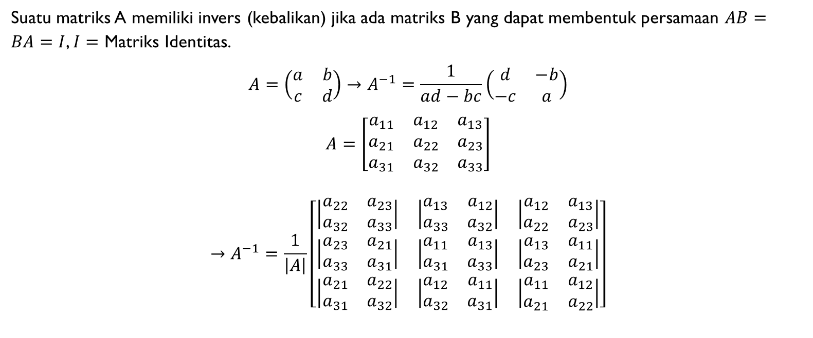
INVERS
Suatu matriks A memiliki invers (kebalikan) jika ada matriks B yang dapat membentuk persamaan $AB=BA=I$, $I=$ Matriks Identitas.
$$A=\left(\begin{matrix}a & b \\ c & d\end{matrix}\right)→A^{−1}=\frac{1}{ad−bc}\left(\begin{matrix}d & −b \\ −c & a\end{matrix}\right)$$
$$A=\left[\begin{matrix}a_{11} & a_{12} & a_{13} \\ a_{21} & a_{22} & a_{23} \\ a_{31} & a_{32} & a_{33}\end{matrix}\right]$$
$$→A^{−1}=\frac{1}{\left|A\right|}\left[\begin{matrix}\left|\begin{matrix}a_{22} & a_{23} \\ a_{32} & a_{33}\end{matrix}\right| & \left|\begin{matrix}a_{13} & a_{12} \\ a_{33} & a_{32}\end{matrix}\right| & \left|\begin{matrix}a_{12} & a_{13} \\ a_{22} & a_{23}\end{matrix}\right| \\ \left|\begin{matrix}a_{23} & a_{21} \\ a_{33} & a_{31}\end{matrix}\right| & \left|\begin{matrix}a_{11} & a_{13} \\ a_{31} & a_{33}\end{matrix}\right| & \left|\begin{matrix}a_{13} & a_{11} \\ a_{23} & a_{21}\end{matrix}\right| \\ \left|\begin{matrix}a_{21} & a_{22} \\ a_{31} & a_{32}\end{matrix}\right| & \left|\begin{matrix}a_{12} & a_{11} \\ a_{32} & a_{31}\end{matrix}\right| & \left|\begin{matrix}a_{11} & a_{12} \\ a_{21} & a_{22}\end{matrix}\right|\end{matrix}\right]$$

Slide 4

SIFAT-SIFAT LAIN PERKALIAN MATRIKS
$AX=B→X=A^{−1}B$
$XA=B→X=BA^{−1}$
${\left(AB\right)}^{−1}=B^{−1}A^{−1}$

Slide 5

MATRIKS TIDAK KOMUTATIF
$$AB≠BA$$
$A=\left[\begin{matrix}1 & 2 \\ 3 & 4\end{matrix}\right]$ dan $B=\left[\begin{matrix}5 & 6 \\ 7 & 8\end{matrix}\right]$

Slide 6

HUKUM ASOSIATIF
$$\left(AB\right)C=A\left(BC\right)$$
$A=\left[\begin{matrix}3 & 2 \\ 6 & 1\end{matrix}\right]$ $B=\left[\begin{matrix}4 & 9 \\ −1 & 0\end{matrix}\right]$ $C\left[\begin{matrix}4 & 2 & 5 \\ 1 & 3 & 2\end{matrix}\right]$

Slide 7
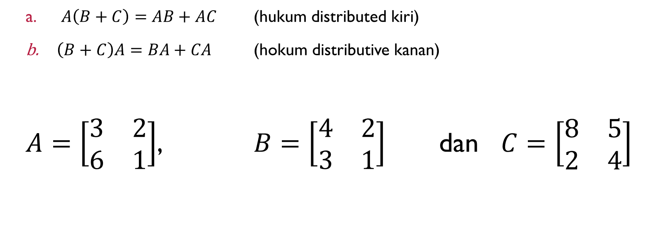
HUKUM DISTRIBUTIF KANAN DAN KIRI
$A\left(B+C\right)=AB+AC$ (hukum distributed kiri)
$\left(B+C\right)A=BA+CA$ (hokum distributive kanan)
$A=\left[\begin{matrix}3 & 2 \\ 6 & 1\end{matrix}\right]$, $B=\left[\begin{matrix}4 & 2 \\ 3 & 1\end{matrix}\right]$ dan $C=\left[\begin{matrix}8 & 5 \\ 2 & 4\end{matrix}\right]$

Slide 8

PERKALIAN DENGAN MATRIKS IDENTITAS
$$AI=IA=A$$
$$A=\left[\begin{matrix}1 & 2 \\ 3 & 4\end{matrix}\right]$$

Slide 9

PERPANGKATAN MATRIKS
$$A^{0}=I, A^{k}=AAAA…A\left(k kali\right).$$
$$A=\left[\begin{matrix}1 & 2 \\ 3 & 4\end{matrix}\right]$$

Slide 10

MATRIKS ORTHOGONAL
$${AA}^{T}=A^{T}A=I$$
$$A=\left[\begin{matrix}8 & 5 \\ 2 & 4\end{matrix}\right]$$

Slide 11

$${AA}^{−1}=A^{−1}A=I$$
$$A=\left[\begin{matrix}3 & 2 \\ 6 & 1\end{matrix}\right]$$

Slide 12
Sekian dan terima kasih

